Slide 1
Data Management
11013346 – Riya Lalwani

Slide 2
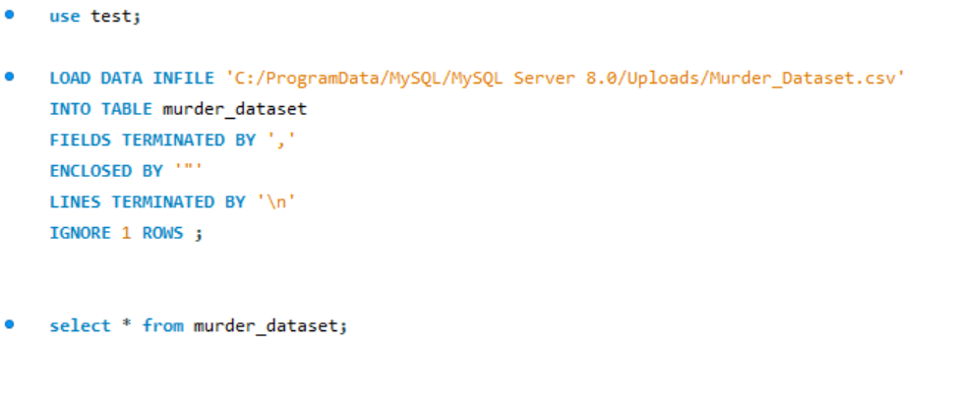
Data Loading
Loaded the data into SQL workbench using below code :

Slide 3
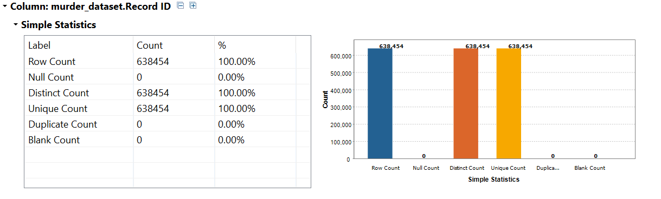
Data Profiling using Talend Data prep
Step 1: Create Database Connection
Step 2: Performed Basic Column Analysis on all the columns using simple statistics
Example as Below:
*Observation*
Uniqueness factor: Compared the row count with unique count and came to know that Record ID column is unique

Slide 4
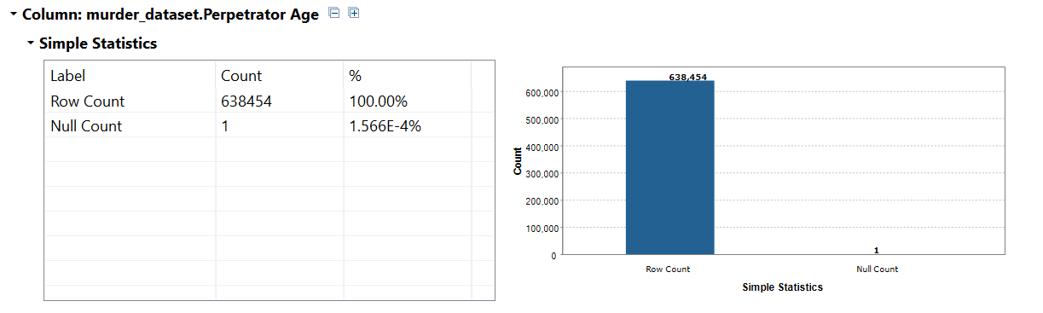
*Observation*
Completeness indicator: identified columns with nulls/blanks and came to know that there is 1 null value in Perpetrator Age column

Slide 5
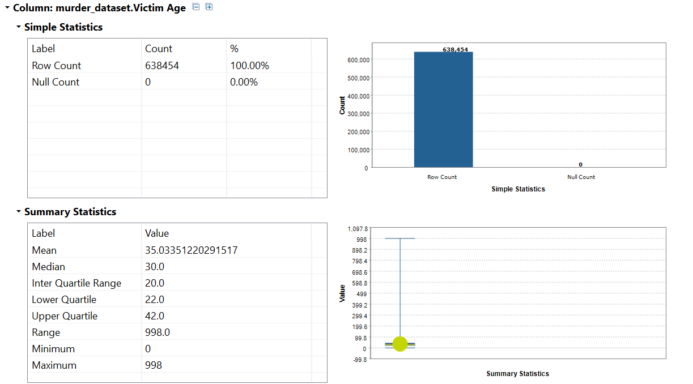
Step 3: Performed Summary Statistics Analysis on all the columns
Example as Below:
*Observation*
Range of Victim age can be known by minimum and maximum values. (currently inaccurate value)
The interquartile range helps to identify spread of the data

Slide 6
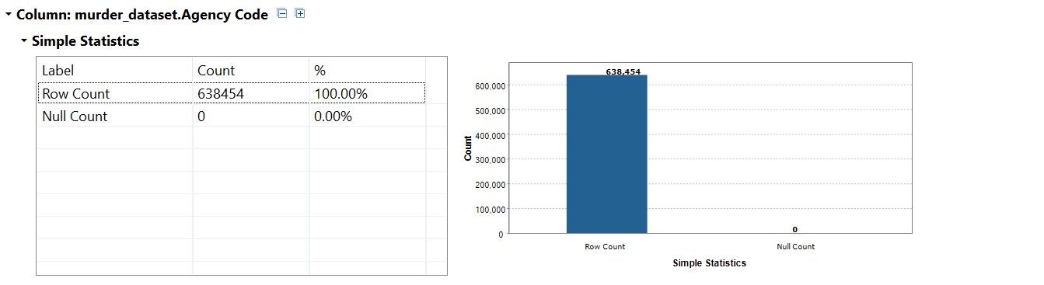
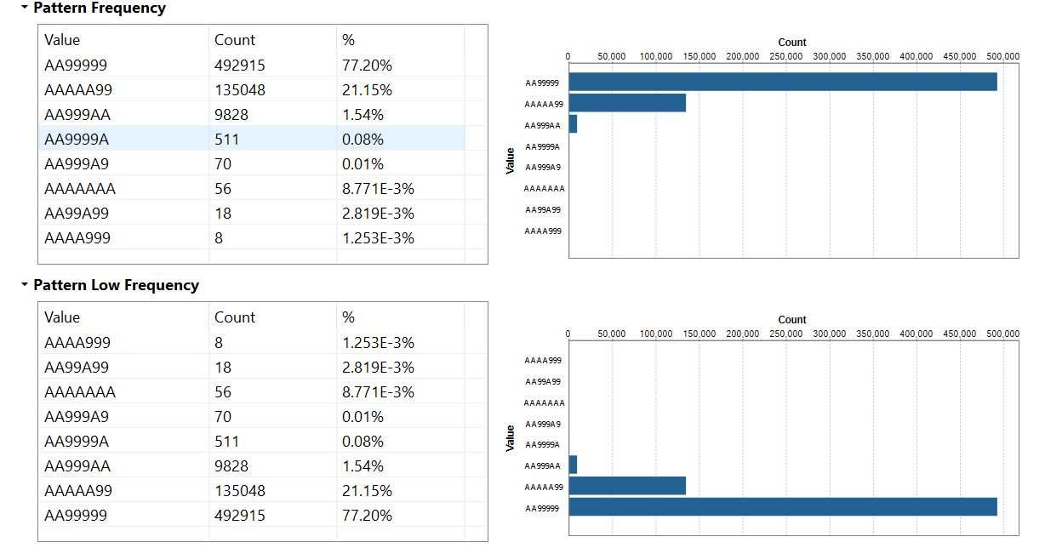
Step 4: Performed Pattern Frequency Analysis on all the columns
Example as Below:
*Observation*
Pattern Frequency of Agency Code, indicates that there are different pattern values in column and also the most common used pattern is “AA99999”

Slide 7
Data Cleaning
Dimensions required for Data Cleaning
Validity and Conformity
Completeness
Timeliness and Currency
Accuracy
Consistency
Reliability

Slide 8
Data Cleaning
User Story 1: Police Department requires the information about the top 10 states, which has the most homicides in United states.
Column Name: State.
Data Quality Dimension:
Accuracy
For Accuracy Dimension, State values which are invalid and present in State column will be replaced with Rhode Island value (Rhode Island is a valid State in United States).
Using Search and Replace function, replaced the value present in State column.

Slide 9
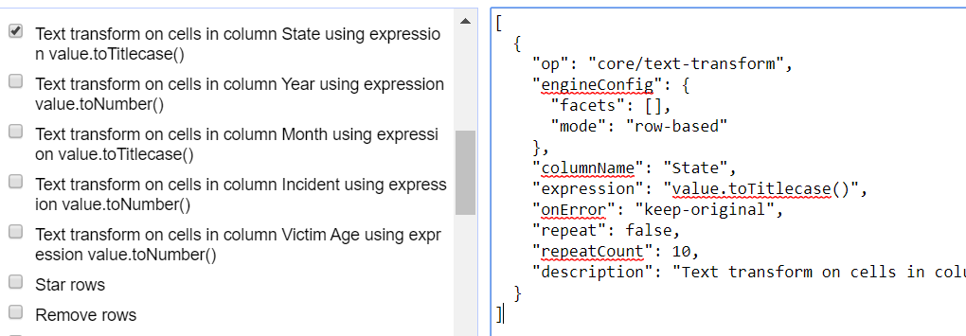
Consistency
For State Column
Columns are made consistent in Title Case based on requirement that first letter of the State must be capital, converted to Title case.

Slide 10
For State Column to be accurate, conformity and validity checks are performed
Facet by State, to check for null and invalid values

Slide 11
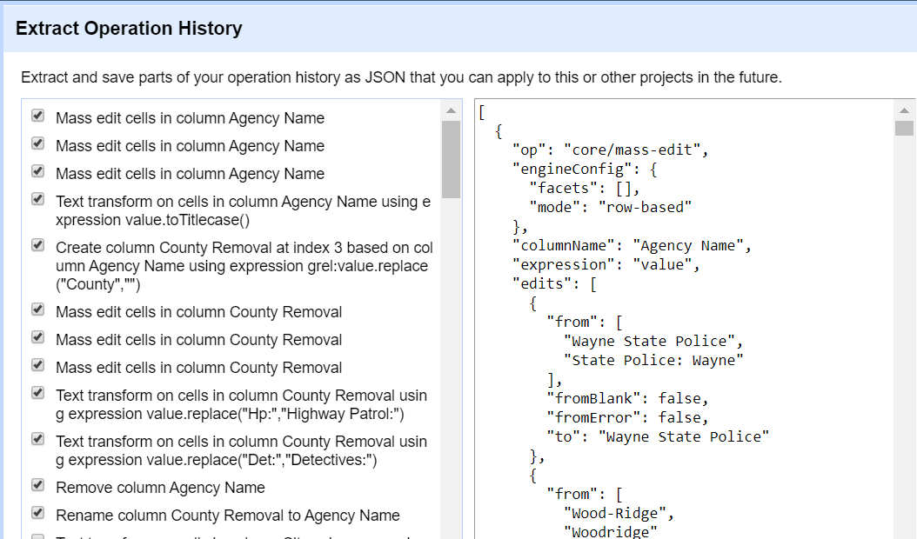
Column is made consistent based on the requirement that same name should have same format
Column: Agency Name
To make agency name consistent, using different techniques of clustering such as key collision, nearest neighbour etc. Clustered the records and found anomalies on which performed edit to combine the rows mass edit.
For Example records were containing Wayne State Police and also State Police : Wayne
There were also some values like Det: Honty and also Detectives : Honty, so replaced using text transform in GREL (value.replace (“Det:”, “Detectives:”)).

Slide 12
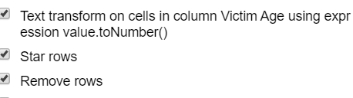
User Story 2: Reporter wants to know the peak age of Victims in united states for his work.
Victim Age
Validity
Converted the column into number and then applied numerical facet in Open Refine to check the range of Victim age and came to know that there are 998 age also in the column so removed the rows which had no information in column Victim age, Victim race, Victim Ethnicity, Perpetrator Age, Perpetrator Count.

Slide 13
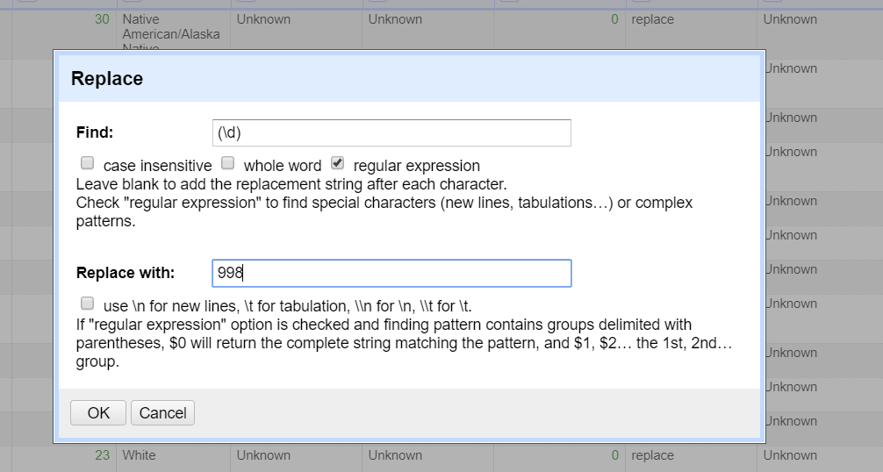
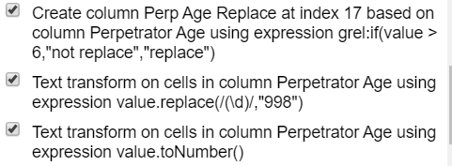
User Story 3: Government wants the details of the crimes committed by Adult person only.
Validity
Converted the column into number and then applied numerical facet in Open Refine to check the range of Perpetrator age and came to know that there arrange from 0-99.
Added new column based on this with condition where age is greater than 6 to determine replacement is required or not. Then facet by text to that column and selecting only replaced columns, performed edit to replace digits with 998. Stated Business rule that 998 means missing. So now, only valid records are available.

Slide 14
Insights gained
With help of data profiling, data cleaning became easy.
The data quality dimensions are linked with each other
For e.g.
Accuracy is related to Conformity and validity.
Consistency is related to Accuracy.
The data quality dimensions are linked with each other

